Slide 1

BOOSTING ALGORITHM
Assignment Prepared by
Shankar K

Slide 2
Why Boosting Algorithm?
Boosting algorithms are used in machine learning to improve the accuracy and performance of models by combining multiple weak learners (typically decision trees) into a strong learner.

Slide 3
1. Improves Accuracy
Boosting reduces both bias and variance.
It sequentially trains models so that each new model focuses on the errors made by the previous ones.
Final predictions are a weighted combination of all learners, leading to better accuracy.
2. Handles Complex Data Well
Boosting can capture non-linear patterns and interactions between features that simple models may miss.
It's especially useful when the relationship between input and output is complex.
3. Reduces Overfitting (in some variants)
Algorithms like Gradient Boosting and XGBoost include regularization techniques (like shrinkage, subsampling) to prevent overfitting.
4. Versatile and Powerful
Works for both classification and regression tasks.
Can handle different types of data and loss functions.
5. Feature Importance
Boosting models (like XGBoost) can show feature importance, helping you understand which features are most influential in predictions.

Slide 4

STEPS
We begin by drawing m subsets from the original training dataset.
The first weak learner is trained using the initial subset.
This trained model is then evaluated on the training data to identify which instances were predicted incorrectly.
The misclassified data points are given more focus in the next subset by updating its composition.
Using this updated subset, we train and evaluate the second weak learner.
This process is repeated for each subsequent subset until all m weak learners are trained.
The final prediction is obtained by combining the outputs of all the weak learners, with the aggregation occurring progressively during training—so no separate calculation is needed at the end.

Slide 5
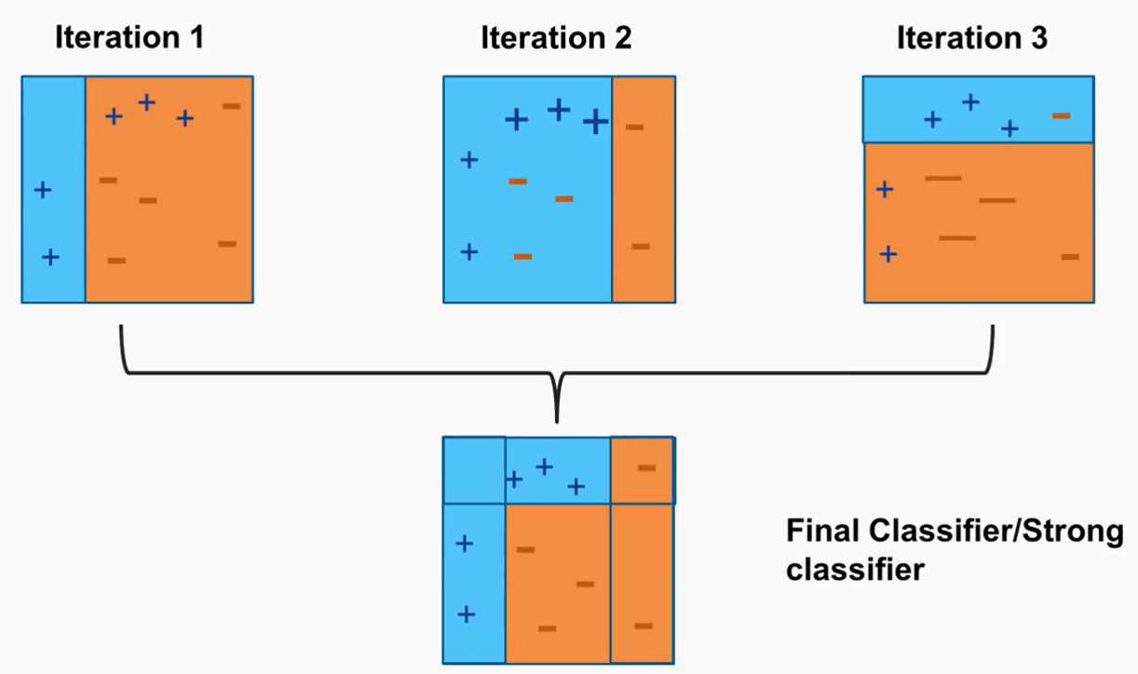

Slide 6
ADABOOST ALGORITHM
Ensemble method in machine learning
Reassign weight to each instance
Higher weights for incorrectly classified
Reduce Bias and Variance

Slide 7
ADABOOST ALGORITHM

Slide 8
Key Concepts of AdaBoost
Weights on Data Points: AdaBoost assigns weights to every data point in the dataset. Initially, all points have equal weight. When a weak learner misclassifies a data point, its weight is increased, making the algorithm focus more on these challenging cases in subsequent rounds.
Weak Learners: These are simple models, like decision stumps, that perform slightly better than random guessing. AdaBoost uses them iteratively, training each one to correct the mistakes of the previous learners.
Strong Classifier: The final model, called the strong classifier, is a combination of all the weak learners. Each weak learner contributes based on its accuracy, and the algorithm combines their outputs using weighted voting to make a robust prediction.
Error Rate: In each iteration, AdaBoost calculates the error rate of the current weak learner. The error rate determines how much influence the learner will have in the final model. A lower error rate means the learner contributes more to the strong classifier.
Iterations: AdaBoost runs for multiple iterations, training weak learners sequentially. With each iteration, it updates the weights based on the performance of the previous learner. The number of iterations influences the strength of the final classifier but also impacts computation time.

Slide 9
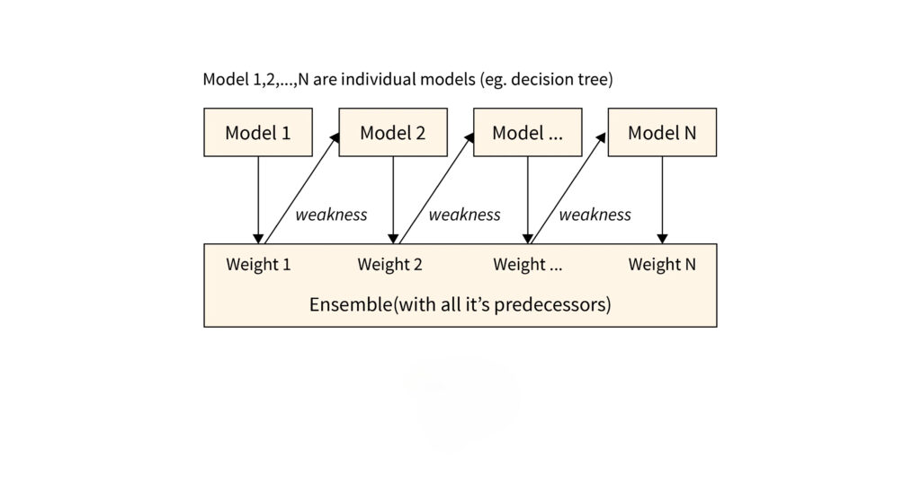

Slide 10

STEPS
Step 1: Creating first base learner
Step 2: Calculate the total Error
Step 3: Calculate the performance of the stump
Performance of the stump =$\frac{1}{2}$ ln$\left(\frac{1−Total Error}{Total Error}\right)$
Step 4: Updating the Weights
New Sample Weight of misclassified data = Sample weight x $e^{(Performance)}$
New Sample Weight of correctly classified data = Sample weight x $e^{−(Performance)}$
Step 5: Creating new datasets
Step 6: Repeating the process

Slide 11
XGBOOST ALGORITHM

Slide 12
Xtreme Gradient Boost Algorithm
XGBoost is a powerful machine learning algorithm
It is designed to optimize performance and computational speed
Open source
Created by Tianqi Chen
Widely accepted algorithms in Kaggle competition

Slide 13
Key Features of XGBoost
Handling Missing Value: XGBoost automatically handles missing values, enabling the model to learn from incomplete datasets without requiring imputation beforehand
Regularization: Incorporates L1 and L2 regularization to reduce overfitting, improving the model’s generalization and performance on unseen data
Tree Pruning: Utilizes a depth-first approach for tree pruning, enhancing efficiency by determining optimal leaf nodes without excessive computational resources.
Parallel Processing: Supports parallel processing of decision trees, significantly decreasing training time while maintaining the integrity of the boosting process
Cache Optimization: All the intermediate calculations are kept in the Cache so that the information received from the cache is very fast
Out of Memory Computation: It can optimize the memory in such a way that it can work with the data larger than the size of the RAM

Slide 14
STEPS
Build a Tree: Create a decision tree to predict these errors.
Update Prediction: Adjust the initial guess using the predictions from this tree.
Repeat: Calculate new errors based on the updated prediction.
Build another tree to predict these new errors.
Adjust the prediction again using this new tree.
Regularization: Use techniques to prevent the model from becoming too complex and overfitting the data.
Combine Predictions: After building several trees, combine their predictions to make the final prediction.
Evaluate: Check how well the final model performs using a separate test dataset.

Slide 15
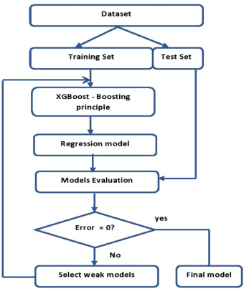

Slide 16
LIGHT GBM ALGORITHM

Slide 17
Light GBM Algorithm
Light GBM Algorithm
LightGBM is a gradient boosting framework that uses tree based learning algorithms
Faster training speed and higher efficiency.
Lower memory usage.
Better accuracy.
Support of parallel, distributed, and GPU learning.
Capable of handling large-scale data.

Slide 18
Features
Reduces the cost of finding the best split.
Pre-sorting has high time complexity: O(#data).
Histogram building is faster (O(#data)) using simple sum operations.
Split finding becomes much quicker: O(#bins), where bins are much fewer than data points.
Uses histogram subtraction to speed up processing of tree nodes.
Builds histogram for only one leaf and derives the other using subtraction (O(#bins)).
Saves memory by converting continuous values to discrete bins (e.g., using small data types like uint8_t).
No extra memory needed for pre-sorting features.
Lowers communication cost in distributed training.

Slide 19
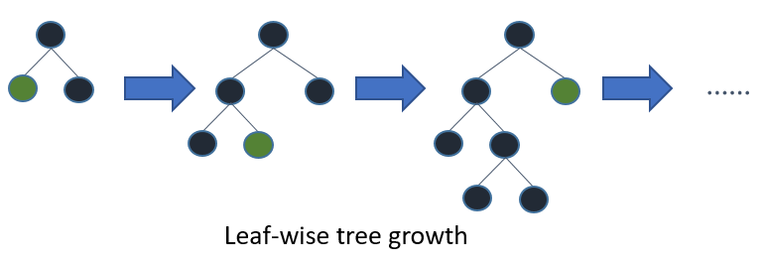

Slide 20
Difference between AdaBoost – XGBoost – Light GBM Algorithms
Feature | AdaBoost | XGBoost | LightGBM
Full Form | Adaptive Boosting | Extreme Gradient Boosting | Light Gradient Boosting Machine
Base Learner | Usually Decision Stumps (1-level trees) | Decision Trees | Decision Trees
Boosting Type | Sequential, adaptive boosting | Gradient Boosting | Gradient Boosting with histogram
Handling of Residuals | Focuses on misclassified samples | Uses gradients (1st derivative) | Uses gradients and histograms
Tree Growth Strategy | Depth-wise | Level-wise | Leaf-wise (with depth constraints)
Speed | Slow with large datasets | Faster than AdaBoost | Fastest among the three
Accuracy | Moderate | High | Very High
Memory Usage | Low | Moderate | Low (due to histogram optimization)
Parallel Processing | No | Yes | Yes
Missing Values Handling | Not handled natively | Handled | Handled
Overfitting Control | Less control | Regularization (L1, L2) | Regularization + Early Stopping
Best Use Case | Simple or smaller datasets | Structured/tabular data | Large datasets with high dimensions

Slide 21
THANKYOU

